Slide 2
SHA
Securing Hash Algorithm

Slide 3
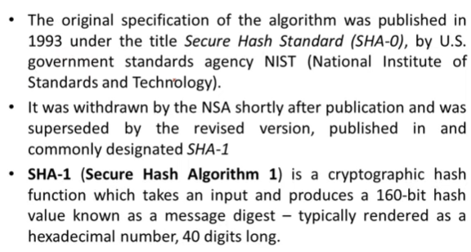
Introduction to SHA

Slide 4
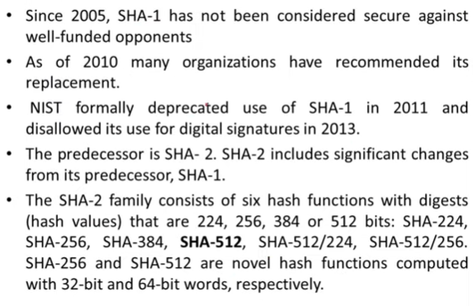

Slide 5
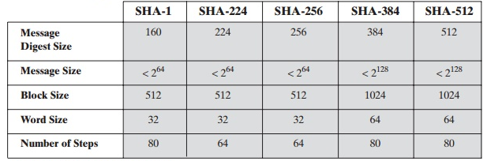
SHA 512 Algorithm
The algorithm takes as input a message with a maximum length of less than 2¹²⁸ bits and produces as output a 512-bit message digest.
The input is processed in 1024-bit blocks

Slide 6
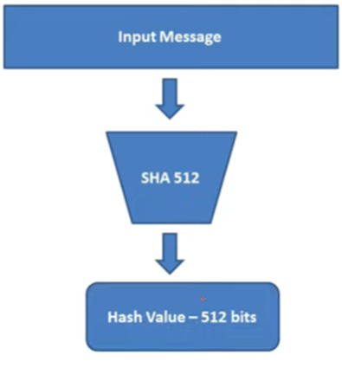
SHA-512

Slide 7
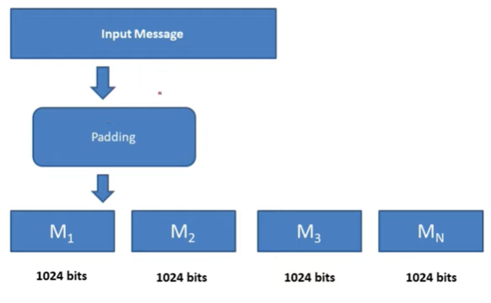

Slide 10
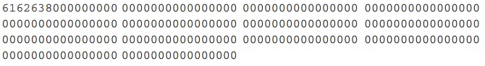

Slide 13
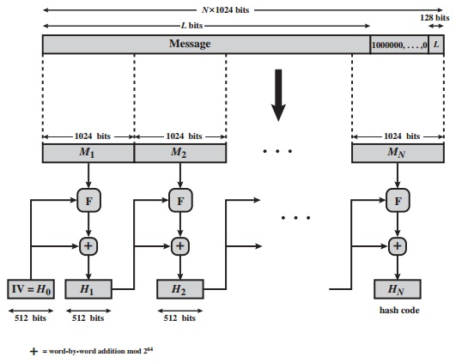
Message Digest Generation using SHA-512

Slide 14
